Slide 1
Loan Repayment Prediction
Sabrina Yang

Slide 2
01
Introduction

Slide 3
Loan Repayment Prediction
Goal
Client
01
02
Predict whether a borrower will repay their loan
Lending institution

Slide 4
Loan Repayment Prediction
Focus
03
04
Predict Target
Only invest on the loan is most likely to pay back
Loan Status
Charged Off Fully Paid

Slide 5

Data Source
Kaggle.com
2.9M Datapoints
140+ Features
13 Years of Data
246K Datapoints
28 Features
3 Years of Data

Slide 6
02
Approach
Classification

Slide 7
EDA
79%
21%
Predict whether a loan status will be Charged Off or Fully Paid
Fully Paid
Charged Off
Notes:
Class imbalance
Ratio 1: 4

Slide 8
Data Features
Borrower Characteristics
Employment Length
Address State
Home Ownership
Loan Traits
Loan Amount
Loan Purpose
Interest Rate
Installments
Terms
Financial Background
Annual Income
Debt to Income Ratio
Ratings and Scores
FICO Score
Lending Club Loan Grade

Slide 9
Data Features
Borrower Characteristics
Employment Length
Address State
Home Ownership
Loan Traits
Loan Amount
Loan Purpose
Interest Rate
Installments
Terms
Financial Background
Annual Income (log)
Debt to Income Ratio
Ratings and Scores
FICO Score
Lending Club Loan Grade
Notes:
DTI (Debt to Income Ratio)
Purpose : Credit Card - > Debt Consolidation

Slide 10
Models Baseline Comparison (F2)
0.20 -> Class Imbalance Fixed ->
0.526
Logistic Regression
KNN
0.199
Random Forest
0.429
XGBoost
0.578

Slide 11
03
Results

Slide 12
Random Forest
Notes:
For potential, I mean by tuning hyperparamters by GridSearchCV

Slide 13
RF 1 Baseline with class imbalance fixed
class_weight="balanced"
F2 score : 0.4295
6,956
Fully Paid
32,138
Actual
5,654
4,453
Charged Off
Fully Paid
Charged Off
Predict
Notes:
class_weight="balanced"

Slide 14
RF 2 Tuned on min_sample_leaf
= 100
(increased from
50 to 100)
F2 score : 0.5323
13,391
Fully Paid
25,703
Actual
3,694
6,413
Charged Off
Fully Paid
Charged Off
Predict
Notes:
Min_sample_leaf = 50 to 100

Slide 15
RF 3 Tuned on Max_features
= log2
F2 score : 0.5325
13,641
Fully Paid
25,453
Actual
3,662
6,445
Charged Off
Fully Paid
Charged Off
Predict
Notes:
Max_features [auto, sqrt, log2]
Log2 the best -> 28 features take log2 = 4.8 -> 5
But the score stucked at 0.532 and barely went up -
> so I moved on to XGBoost

Slide 16
XGBoost

Slide 17
XGB 1 Baseline with class imbalance fixed
scale_pos_weight = 5
F2 score : 0.578
16,830
Fully Paid
22,264
Actual
2,613
7,494
Charged Off
Fully Paid
Charged Off
Predict
Notes:
Different from Random Forest. "scale_pos_weight"
scale_pos_weight = 5
The class imbalance for original dataset is 0.79 (negative) vs 0.20(positive), so the most accurate scale_pos_weight should be around 4, but GridSearchCV shows me 5 worked out well so I choose 5 to continue my tunning. The reason I didn't choose anything above 6 (even their F2 score were higher) is because I don't want my classes got too many positive samples versus negative cases, and I assume the ideal ratio should be balance like 1: 1.

Slide 18
XGB 2 GridSearchCV Tuning
F2 score : 0.585
n_estimator = 300
learning_rate=0.05
min_child_weight = 57
max_depth =5
17,981
Fully Paid
21,113
Actual
2,358
7,749
Charged Off
Fully Paid
Charged Off
Predict
Notes:
N_estimator INCREase to 300
Scale_pos_weight=5
Learning_rate=0.05
Min_child_weight = 57
Max_depth =5

Slide 19
XGB 3 Tuned on subsample
=0.5
F2 score : 0.589
18,057
Fully Paid
21,037
Actual
2,289
7,818
Charged Off
Fully Paid
Charged Off
Predict
Notes:
Subsample =0.5
N_estimator increase to 300
Scale_pos_weight=5
Learning_rate=0.05
Min_child_weight = 57
Max_depth =5
Fbeta 2 score getting better after tuning
________________.
The confusion matrix looks better now so I checked the features importance here

Slide 20
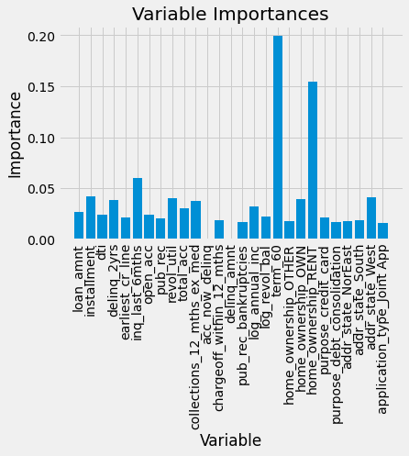
Feature Importance
Term
60 mons
The model picked up on this feature the most
(not equal to coefficient here)
Notes:
. 1. Term_60 is the most important with the highest coefficient
36 versus 60 months and 60 is mote likely to default.
Paying their loan over a longer period of time is more difficult when the borrower is going through financial hardship
2. Home_ownership
RENTis more likely to charge off than OWN
3. number of inquiry_last_6mths
more times of inquries got made in last 6 months can indicated the borrowers were under more financial stress or spending, so it could lead to more probabilty of failing to payback.
4. Address State
West is more likely to default than South, which is more likely to default than North East
DTI (Debt to Income Ratio)
is important for many credit rating agencies and banks, but it's not on top important feature in my model

Slide 21
XGB with Fin Pro - Confusion Matrix
F2 score : 0.915
2,138
Fully Paid
36,956
Actual
561
9,546
Charged Off
Fully Paid
Charged Off
Predict
Notes:
add back Financial Professional features
The score boost up to 0.9. Means these are definitely very good predictors
Let's see what features are important.
TP , TN are up
FP , FN drops a lot

Slide 22
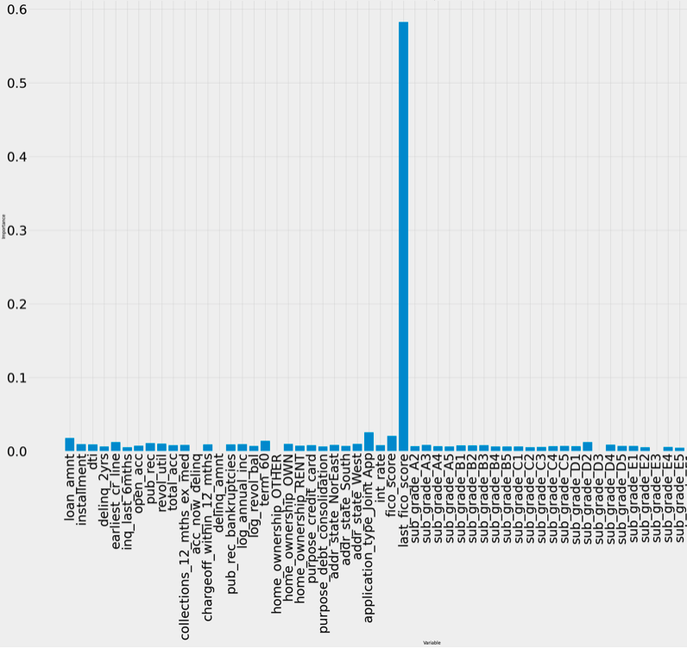
Feature Importance
Last FICO score
Something wrong….
Might be data leaking
because the score was calculated after the loan was given
Notes:
Last FICO score!!!
0.58
Application type: Joint > Individual
Subgrade D2 : the breaking line
Fico score : 0.02 – loan amount –
Different from our coef importance
1. term 60 ( #5) - less important – 0.014
2.home_ownership_: OWN > RENT

Slide 23
Classification Suggestion
Last FICO score (high)
Loan Amount
Term (36m)
Application Type (Individual)
Good borrower!
Notes:
Our Client Bank –
check FICO : high
Appl : individual
loan amoun , term (36M) -> find Sweet Spot for good borrower!
By using this model, we can Lower the risk of borrower defaults , the lender will face a lower chance of its borrowers defaulting and thus help the business to earn higher profits and maintain more customer relationships.

Slide 24
Future Work
More Tune!
XGBoost (computationally expensive)
early_stopping_rounds
colsample_by_tree
compare my improved model with Fin PRO features
More data points!
keep null vales for Random Forest/ XGBoost
Size matters - parameters will be different too
Notes:
More Tune ! More data!
1000 -> 10k -> 100 k , parameters are different

Slide 25

Thanks!
Notes:
And here’s how to keep your FICO score

Slide 26
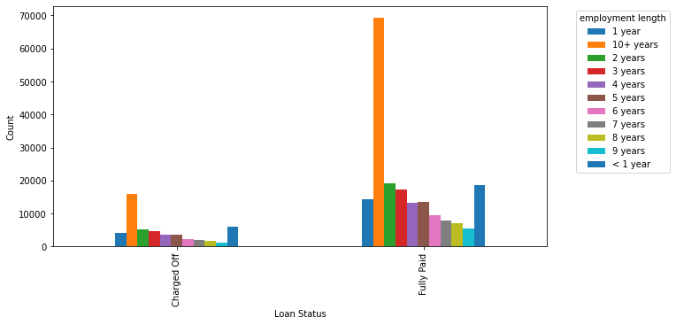
Employment Length
Borrower Characteristics
Loan Traits
Financial Background
Ratings andScores

Slide 27
Appendix
Tools:
Sklearn – LogisticRegression
RandomForestClassifier
GridSearchCV
Fbeta_score
Confusion_matrix
Classification_report
Xgboost - XGBClassifier
Numpy
Pandas

